Slide 1
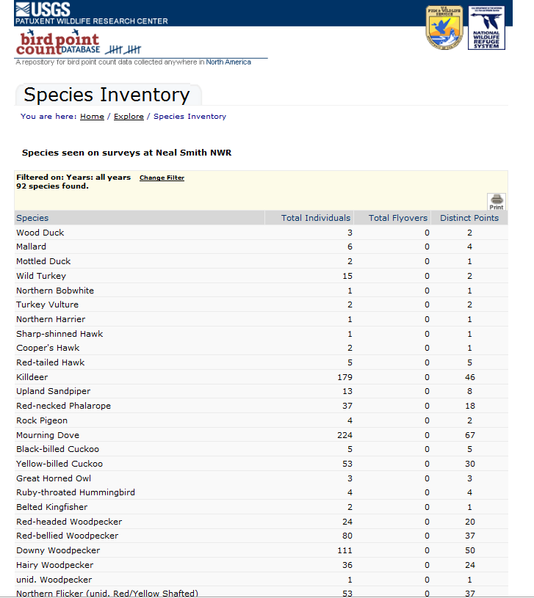
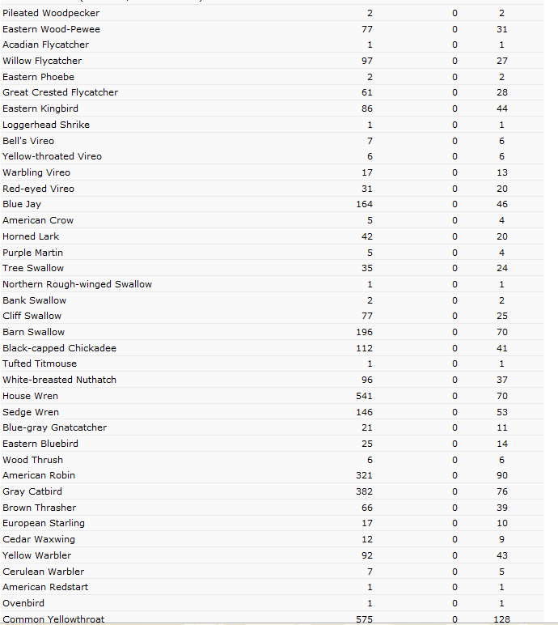
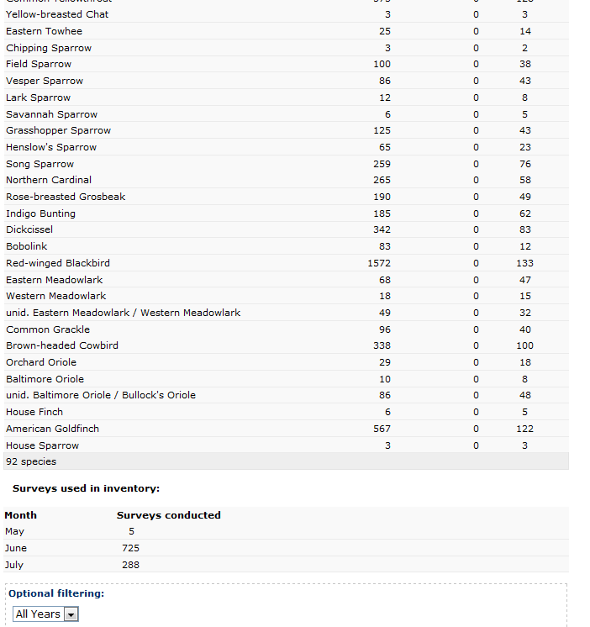
Species Inventory
Neal Smith NWR
Iowa

Slide 2
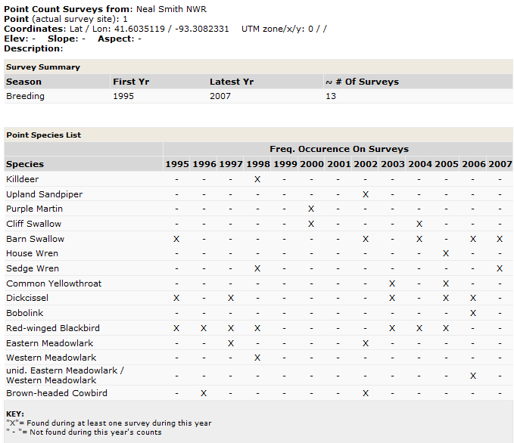
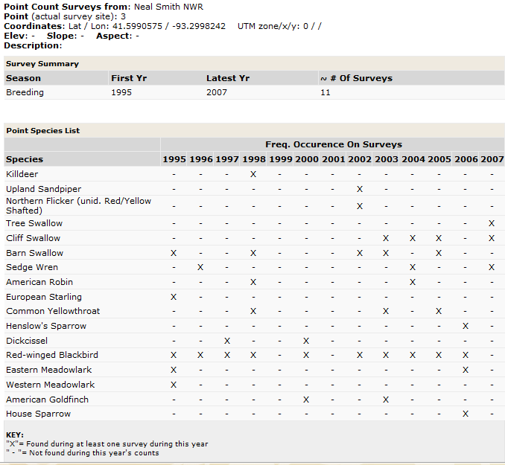
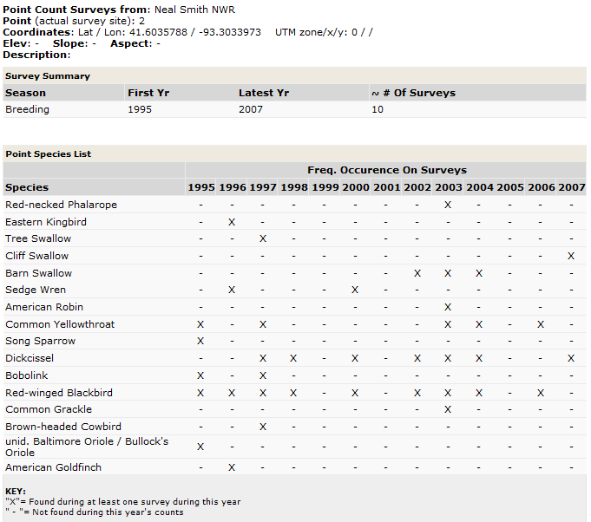
Point 1
Point 3
Point 2

Slide 3
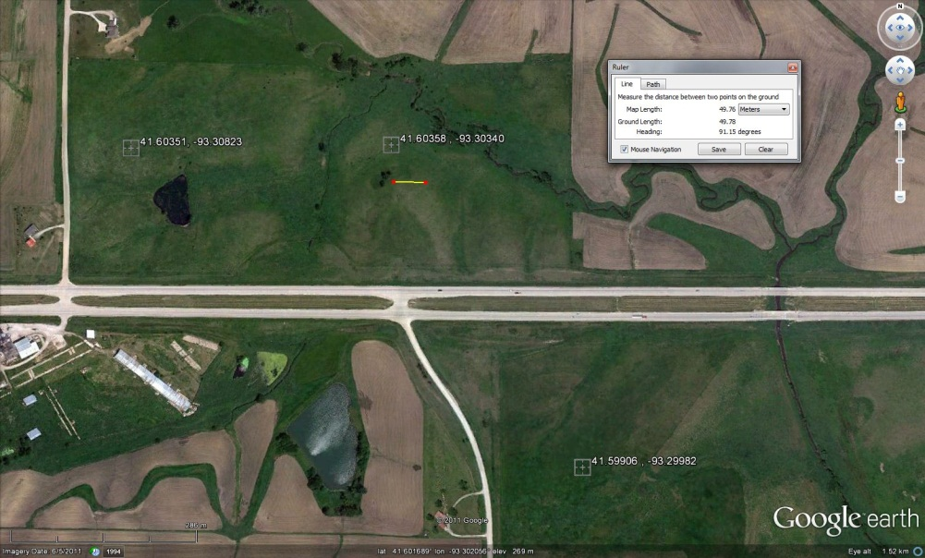
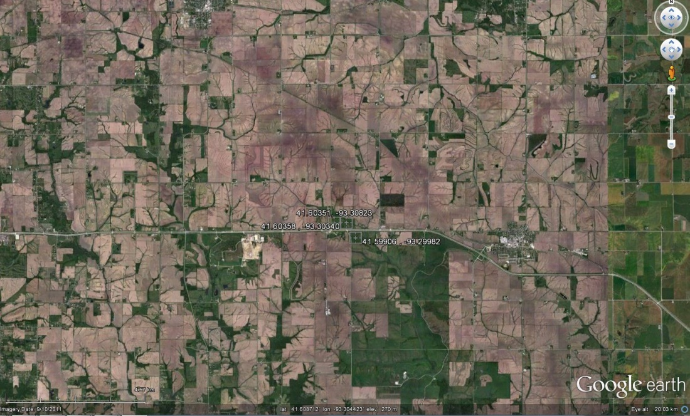
Local GoogleEarth
Points 1-3
Regional GoogleEarth
Points 1-3

Slide 4

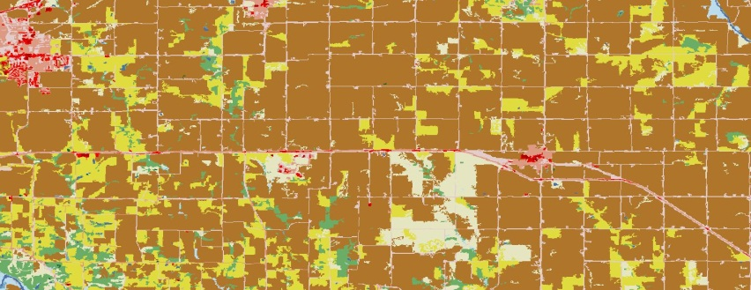

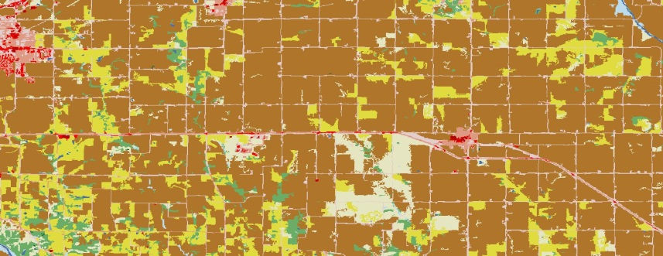

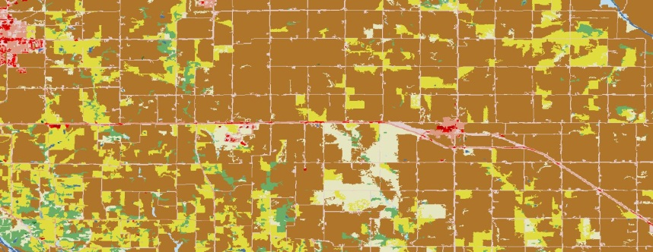
Local Land Cover
Regional Land Cover
Point 1
Point 2
Point 3

Slide 5
Local Land Cover
Regional Land Cover
Point 1
Point 2
Point 3

