Slide 1
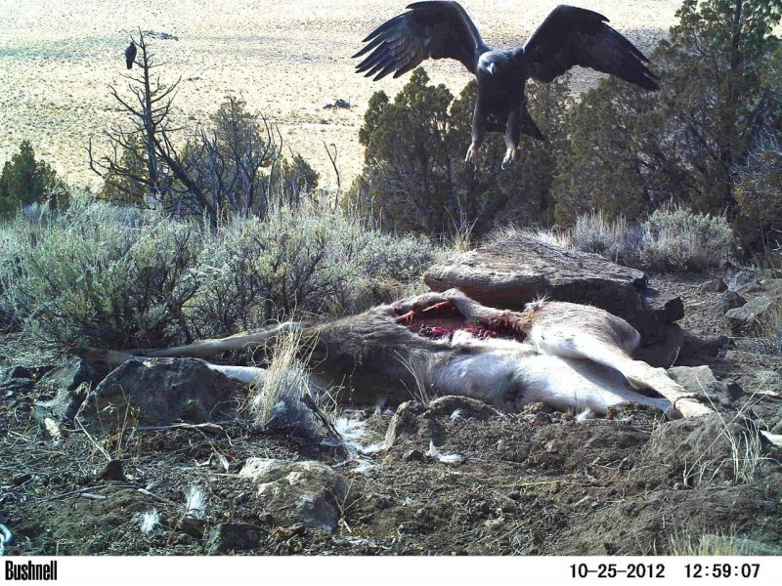
Testing hypotheses about behavioral interactions between cats, coyotes, and birds at carcasses
SLIDE 1.
PLEASE NOTE: Slide numbers are upper left of each
Slide and do not correspond to numbers in left panel.
Ecoed Digital Library
Photo Jon Nelson
Photo Jon Nelson
Notes:
Slide 1. Title Slide.

Slide 2
If you are using the Powerpoint version of this presentation…
SLIDE 1b
There are notes associated with each slide at the bottom of each slide.
You can open and close the notes at the bottom of a slide by hitting “ctrl-shift-h.”
You can change the size of the notes panel by clicking on the dividing line between the notes and the slide and dragging it up or down.
When the notes are longer than the size of the panel, you can read down by dragging the scroll bar.
Notes:
Instructions on note access in Powerpoint.

Slide 3
If you are using a pdf version of this presentation…
SLIDE 1c
We recommend the Powerpoint version, but if it is too big for you to download then you can also use the pdf version. You can read the notes associated with each slide in the pdf version by clicking on the icon on the top left of each slide.
The relevant icon is the orange quote box, as shown in a screenshot here from slide 3:
If the note is too long to read, click on it.
To open all notes in every slide, right click on the icon in one slide and choose “open all popups.”
Notes:
Instructions on access in a pdf version.

Slide 4
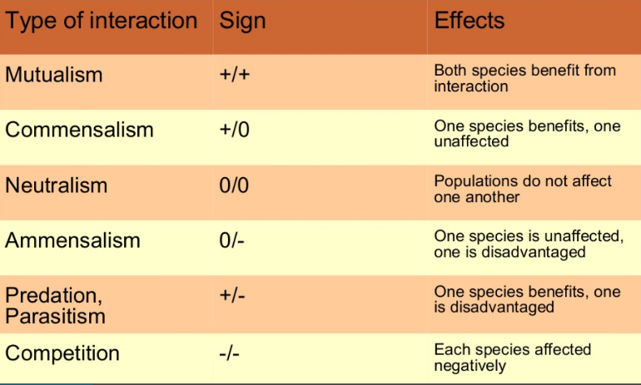
SLIDE 2a.
Notes:
Slide 2. Review of ecological interactions and terms

Slide 5
SLIDE 2b.
Other terms:
Exploitative competition – Competition is indirect (e.g. one species uses up a resource before another species accesses it).
Interference competition – Competition is direct (e.g. physical aggression).
Conspecific – Individual of the same species.
Heterospecific – Individual of a different species.
Carcass – The dead body of an animal.
Carrion – The decaying flesh of dead animals.
Social information – Information gained by observing other individuals.
Cue - Any behavior that inadvertently provides social information during performance of an activity.
Signal – A behavior that intentionally conveys social information.
Notes:
Slide 2b. Slide 2. Review of ecological terms

Slide 6
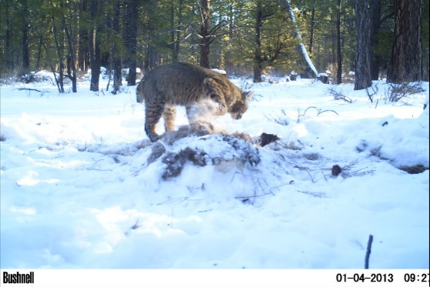
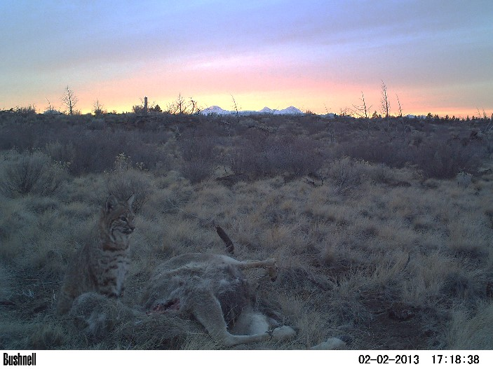
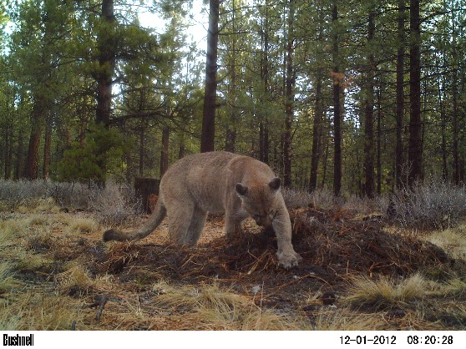
SLIDE 3.
Cats at Carcasses
Photos Jon Nelson
Notes:
Slide 3
BACKGROUND - In Oregon and Washington from 2011 – 2017, scientists placed 89 road-kill deer carcasses into remote locations during cold months of the year, and monitored them using game cameras. In terms of cats, 8 of the 89 carcasses were visited by cougars and 4 were visited by bobcats. These photos show a few of the cat visitations. Note that in the photos, the carcass is either fully apparent (left photo), buried in snow (upper right photo), or buried in pine needles (lower right photo).
QUESTION 1 - What type of ecological interaction do you think best explains the cats’ tendency to bury a carcass after encountering a dead animal - (a) interference competition; (b) exploitative competition; (c) mutualism; (d) commensalism; (e) amensalism? State your answer in the form of a working hypothesis, i.e. “Our hypothesis is that cats bury a carcass in order to _______________. This represents a form of (choose one option from a-e).”
QUESTION 2 - Describe one testable prediction you would make that would allow you to further examine your hypothesis. State it as follows: “If cats bury carcasses in order to _________________, then we predict that we could measure ________________ and it would show ___________________.”

Slide 7
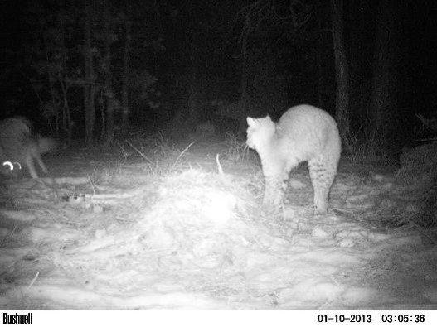
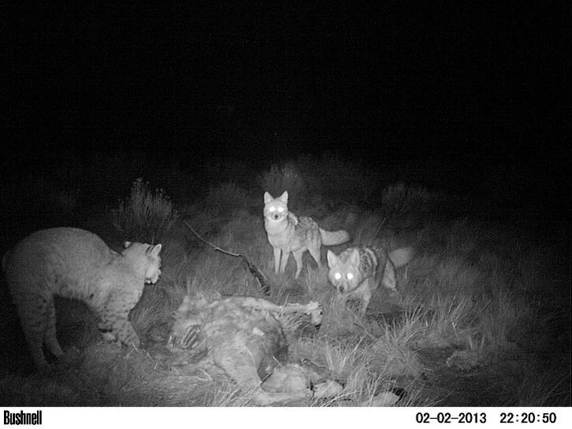
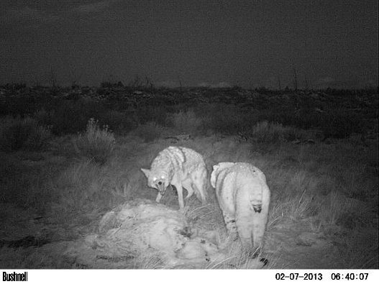
SLIDE 4.
Cats and Dogs
Photos Jon Nelson
Notes:
Slide 4.
BACKGROUND - We occasionally captured scenes between coyotes and bobcats like those shown here.
QUESTION 3. What type of ecological interaction do you think is happening in these photos - (a) interference competition; (b) exploitative competition; (c) mutualism; (d) commensalism; (e) amensalism? State your answer in the form of a working hypothesis, i.e. “Our hypothesis is that bobcats and coyotes exhibit (choose one option from a-e) at a carcass because _______________.”
QUESTION 4. Describe one testable prediction you would make that would allow you to examine your hypothesis from Question 3. State it as follows: “If cats and coyotes exhibit (choose one option from a-e) at a carcass, then we predict that we could measure ________________ and it would show ___________________.”

Slide 8
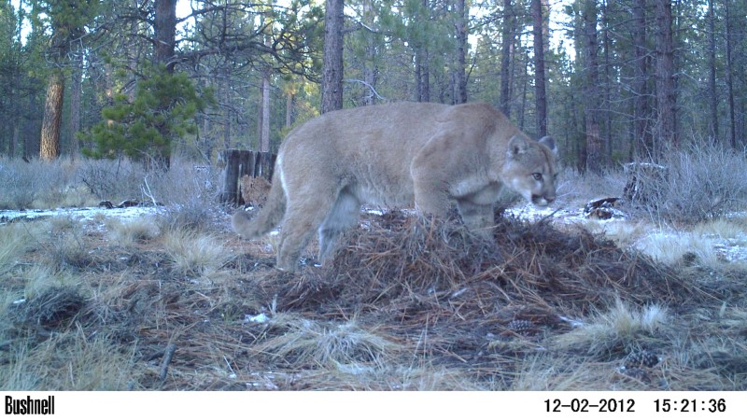
SLIDE 5.
Cougars
Photo Jon Nelson
Notes:
Slide 5.
BACKGROUND. This cougar has buried a carcass in pine needles. Even though cougars appeared at 9% of carcasses, and coyotes appeared at 66% of carcasses, coyotes and cougars never once appeared in the same photograph together.
QUESTION 5. List TWO hypotheses for why coyotes often appeared in photos at carcasses guarded by bobcats, but never at carcasses guarded by cougars. How would you discriminate between your hypotheses? Answer the question in the form of “I would predict that if ___(hypothesis A)__ is correct, then ____(result X) __ should occur.” Alternatively, try to make a statement of this form: “If __(result X) occurs, then this would be sufficient to eliminate (hypothesis A) as a possible explanation.” Make sure that your prediction is something that you realistically could test by gathering data.

Slide 9
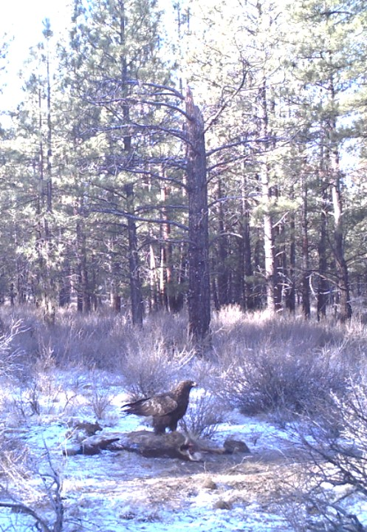
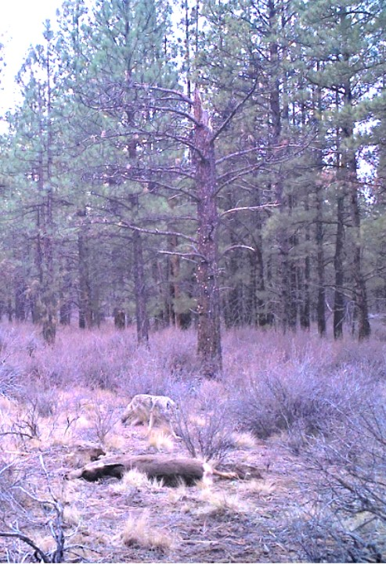
SLIDE 6.
Birds & Dogs
Photos Matt Orr
Notes:
Slide 6.
BACKGROUND. Birds comprise a major component of the scavenging community at carcasses in the study area. The photo on the left shows a golden eagle, which is a very common scavenger. The photo on the right shows a coyote visiting the same carcass.
QUESTION 6. If you had to guess, would you imagine that golden eagles drive coyotes from carcasses, coyotes drive golden eagles from carcasses, or that the outcome can vary?

Slide 10
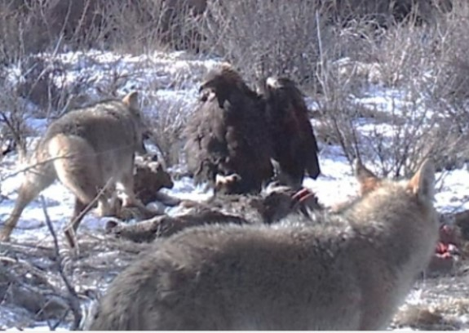
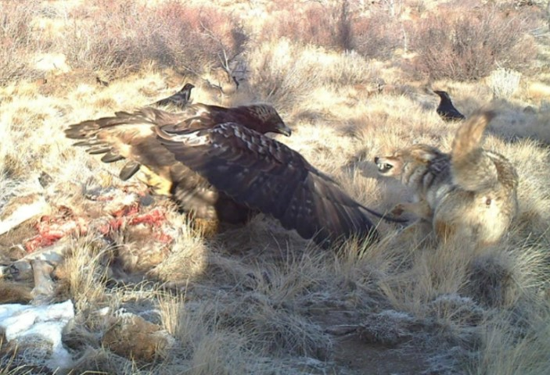
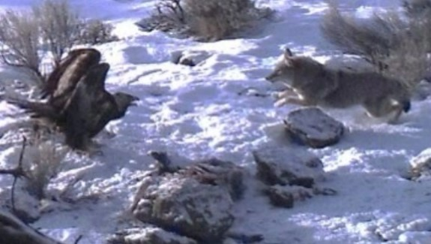
SLIDE 7.
Golden Eagles & Coyotes
Photos Jon Nelson & Matt Orr
Notes:
BACKGROUND. Golden eagles do not back down to coyotes, as seen in the three carcasses pictured here. What sort of competition does this look like to you? As a side note, our cameras never captured a single photograph of a bird of any species in the same frame as a bobcat or cougar, suggesting that cats pose a greater danger to eagles than coyotes do. Our cameras also never captured a photo of cats, dogs, or birds actually making contact with one another, suggesting that although a lot of aggressive posturing happens, there is seldom any contact or injuries inflicted on animals.

Slide 11
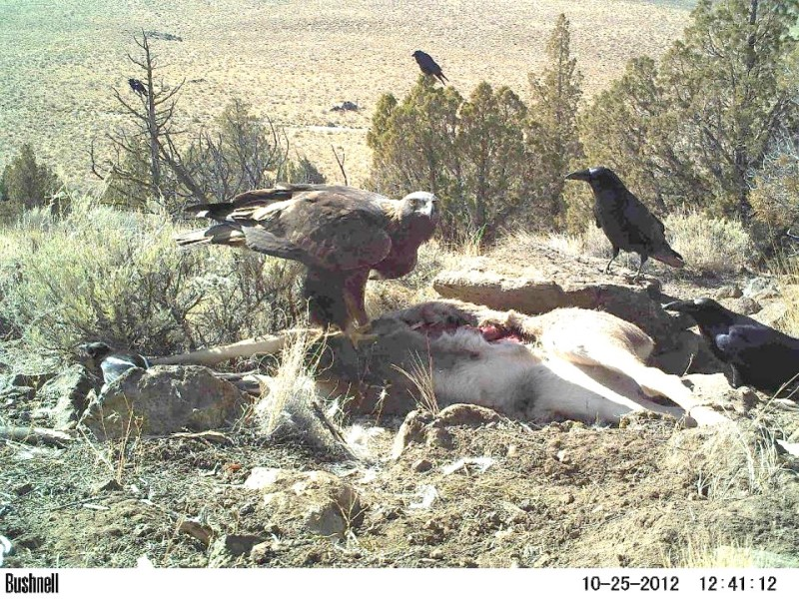
SLIDE 8.
Birds and Birds
Photo Jon Nelson
Notes:
BACKGROUND. Corvids (ravens and magpies) are other common avian scavengers. Here is a photo of a golden eagle with ravens. Game cameras did not register the sorts of aggressive posturing between eagles and ravens that we commonly saw between cats and coyotes and between eagles and coyotes.
QUESTION 7. What type of ecological interaction do you think is happening in these photos - (a) interference competition; (b) exploitative competition; (c) mutualism; (d) commensalism; (e) amensalism? State your answer in the form of a working hypothesis, i.e. “Our hypothesis is that eagles and corvids exhibit (choose one option from a-e) at a carcass.” If you think there is more than one possibility (i.e. the photos do not clearly document the exact option between a-e), then state your answer in terms of two alternative (competing) working hypotheses, i.e. “One hypothesis is that eagles and corvids exhibit (choose one option from a-e) at a carcass. An alternative hypothesis is that they exhibit (choose one option from a-e) at a carcass.”
QUESTION 8. Describe one testable prediction you would make that would allow you to either examine your lone hypothesis (if you described just one) or to discriminate between your competing hypotheses (if you described more than one hypothesis) in Question 7. State it as follows: “If eagles and corvids exhibit (choose one option from a-e) at a carcass, then we predict that we could measure ________________ and it would show ___________________.”

Slide 12
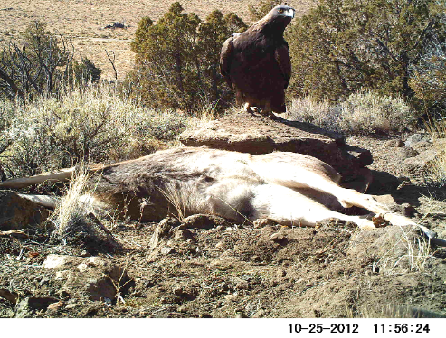
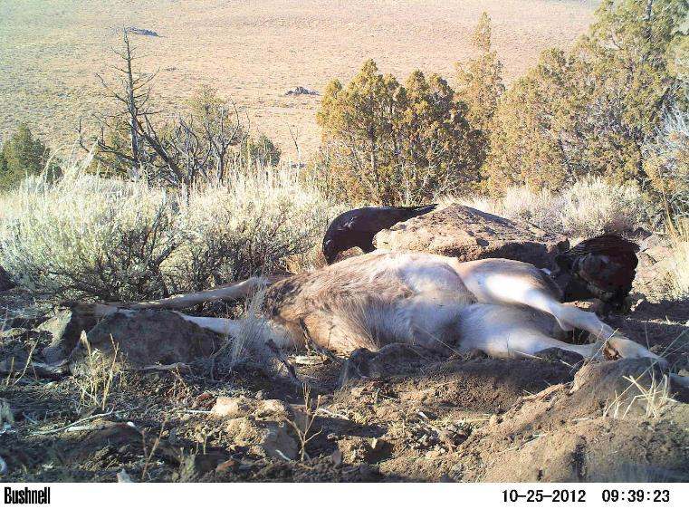
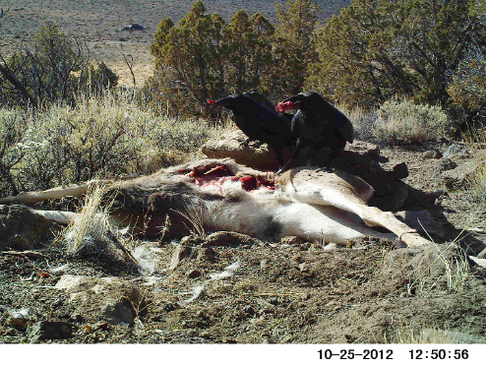
SLIDE 9.
Note in this photo that ravens are feeding at the eyes and anus.
Photos Jon Nelson
Notes:
BACKGROUND. Do the photos shown above make you more confident or less confident in the type of ecological interaction you chose in the previous question? To answer this question, you will need to observe carefully each photo. Note the time stamps on the photos and on the photo in the previous slide.
QUESTION 9. Do your observations modify whether your would choose (a) interference competition; (b) exploitative competition; (c) mutualism; (d) commensalism; (e) amensalism (f) none of the above? After you form a hypothesis for which of the possibilities listed in a-e you think is happening, write a statement of the form: “My hypothesis is that ___________________ is happening. To test my hypothesis, I would predict ______________________. (Make sure your prediction is testable!)

Slide 13
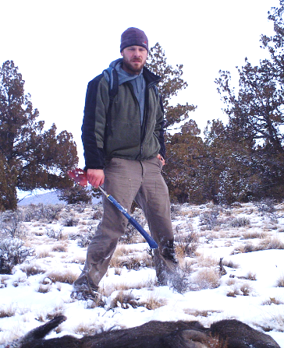
SLIDE 10.
Using a hatchet to experimentally pre-open a carcass.
Photo Jon Nelson
Notes:
BACKGROUND. Here is what scientists did to test the hypothesis that COMMENSALISM is happening at a carcass. They believed that ravens may benefit from having eagles open a carcass, while eagles may be neither helped nor harmed by the presence of ravens (because there is more meat to go around than an eagle can eat). To test whether corvids may benefit from raptors opening a carcass, they put out two kinds of carcasses. Half (N = 5) were “pre-opened” using a hatchet, and the other half (N = 5) were fully intact. They then measured where on a carcass ravens and magpies fed before and after a raptor arrived. Because birds could choose to change locations on a carcass at least once every minute, they examined photos > 1 minute apart and tallied where on the carcass corvids were seen to be feeding in each photo. They were particularly interested to see if corvids shifted from feeding at the eyes and anus to feeding on meat after a raptor visited a closed carcass. They predicted that they would shift toward meat after a raptor visited a carcass, and that no similar change would occur at pre-opened carcasses.
RESULTS & ANALYSIS. The five closed carcasses were visited by 5 ravens and 3 magpies. The five pre-opened carcasses were visited by 4 ravens and 2 magpies. Data on their foraging locations on a carcass are in the Excel file, in the tab labeled “Feeding Locations.” You may analyze the data in that tab by using the link to the Mann-Whitney U test, or, if your instructor does not assign this statistical test, proceed to the next slide.

Slide 14
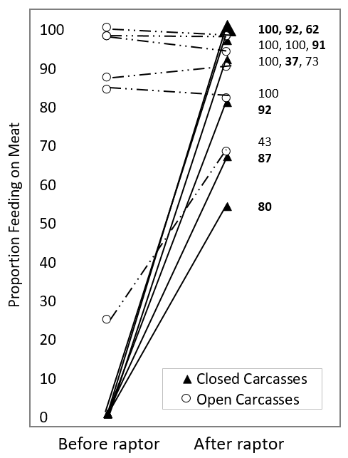
SLIDE 11.
Proportion of instances of ravens or magpies photographed feeding at meat before versus after raptors arrived at closed (dark triangle, solid line) and experimentally pre-opened (open circle, dashed line) carcasses. The proportion of feeding instances on meat increased at closed but not at pre-opened carcasses after a raptor arrived (P < 0.01). Numbers to the right represent number of individual feeding location photos for each carcass (bold = closed carcasses). The large triangle represents 3 different carcasses that had the same result.
Notes:
QUESTION 10. Do the quantitative data shown in Slide 11 (and tested statistically in Excel, if the statistical test was assigned) support your hypothesis for whether the interactions between corvids and raptors is (a) interference competition; (b) exploitative competition; (c) mutualism; (d) commensalism; (e) amensalism (f) none of the above? Explain your answer.

Slide 15
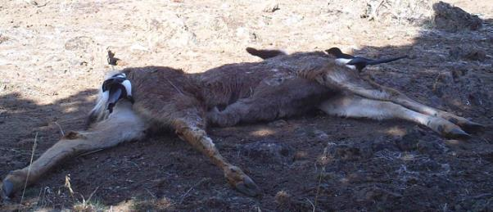
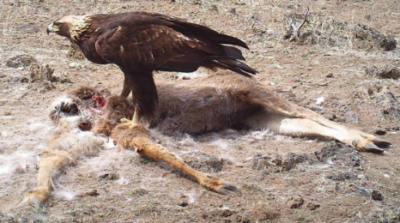
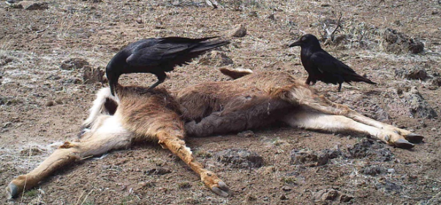
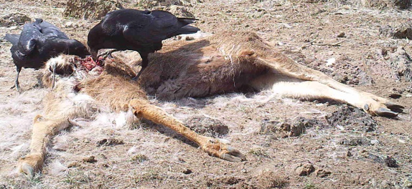
SLIDE 12.
1.
3.
Photos J. Nelson
2.
4.
Summary of Corvid Benefit - 1. Magpies feed at eyes and anus. 2. Ravens feed at eyes and anus. 3. Golden eagle opens skin. 4. Corvids feed on meat.
Notes:
In summary, corvids appear to benefit after a raptor opens a carcass.
QUESTION 11. If the raptor has no reciprocal benefit, then is this a case of (a) amensalism, (b) commensalism, or (c) mutualism?
Is there anything more to these interactions than we have seen so far? Does the raptor get anything out of the deal? Go to the Excel data sheet and open the “Hours to Bird Appearance” tab. Follow the directions in the tab, which are also described in the Notes section of the next slide.

Slide 16
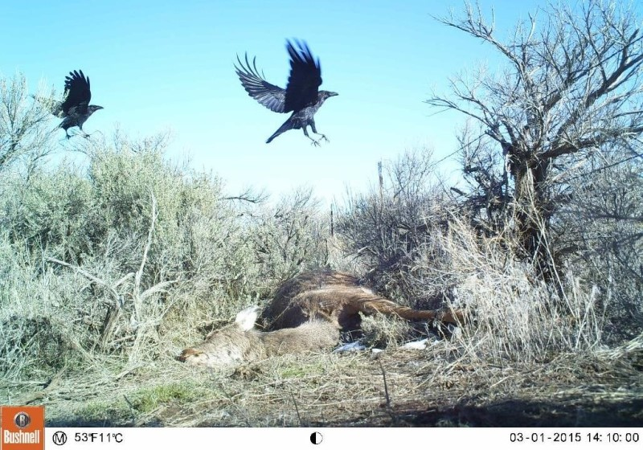
SLIDE 13.
Bird Arrival Times
Photo Matt Orr
Notes:
BACKGROUND. There was an interesting pattern for when corvids and raptors showed up at a carcass. You can see the pattern by making a figure in Excel.
OPTIONAL - INSTRUCTION (GRAPH). Open the Excel data set, if you have not already done so, and click on the tab labeled “Hours to Bird Appearance.” Select all of the data in the rows under “corvid” and “raptor.” Then plot an X-Y scatterplot by choosing “Insert” – “Charts” and “Scatterplot,” which has the icon shown in the slide beneath “Bird Arrival Times.” What do you notice? Sometimes patterns emerge more cleanly when you use log-transformed data. If you wish, repeat using the data in the columns under ln(corvid) and ln(raptor).
QUESTION 12. If you did a graph, it should show that the arrival times of corvids and raptors coincide at carcasses, with corvids usually arriving first. If you were not assigned the Excel portion of the assignment, then simply accept that as true. List up to four reasons why the arrivals of corvids and raptors should coincide at carcasses. Please describe at least two. If you were assigned the plots and regression analyses in Excel, then create a plot and conduct a regression analysis on your log-transformed data. Turn in a copy of your plot and report your R-squared and P values. (Note that in Excel E-15 means “times 10⁻¹⁵.) A P of < 0.05 is considered significant.
QUESTION 13. Describe an experiment you could do to either support or to eliminate from consideration one of the possible reasons you listed in Question 1.

Slide 17
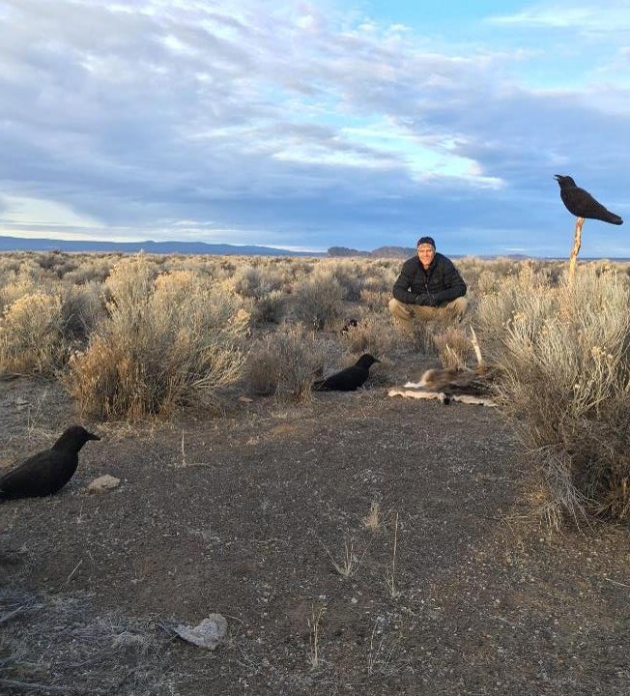
SLIDE 14.
Synthetic Carcasses
This photo shows a synthetic “carcass,” consisting of a deer hide and an antler, seen just in front of the person. Experimental treatments added raven decoys and audio playbacks of scavenging ravens (in a speaker hidden in the bush beneath the raven on the stick). Nearby control treatments, which were observed simultaneously, had no decoys or playbacks—just the “carcass.”
Each experimental and control together was one replicate.
Investigators conducted 16 replicates across a large area.
Photo Soren Orr
Notes:
TYPES OF SCIENTIFIC EXPERIMENTS. So far, the data described about arrival times at carcasses has been observational. That means the investigators just observed birds arriving at carcasses without doing anything to try to directly manipulate their behavior. One shortcoming of observational studies is that they are not controlled, and so their results may be subject to a variety of different plausible interpretations, making it difficult to pinpoint an exact understanding of what is happening. As you probably know, you can narrow things down to a more precise understanding by conducting a controlled experiment, which is sometimes referred to as an experimental study (as opposed to an observational study). In a controlled experiment, one variable is manipulated to differ between a control treatment and an experimental treatment.
BACKGROUND. See the above slide, which describes how control and experimental treatments were created in a Synthetic Carcass study.
RESULTS. Control treatments did not attract birds. Nor did a single raptor show up at the experimental treatments when just the decoys and playbacks were present. However, corvids showed up at 13 of 16 experimental treatments, and raptors showed up at 8 of 16 experimental treatments either when the live corvids were present or within 3 minutes of their departure. Moreover, there was an association between when corvids flew in circles above a synthetic carcass and when raptors arrived.
INSTRUCTION (GRAPH). To examine the relationship between corvid circling and raptor arrival, open the tab titled “Synthetic Carcasses” in the Excel data sheet, and follow the directions at the top of the page.
INSTRUCTION (STATISTICS). Run a regression using the instructions in the “Regression Instructions” tab in the Excel file.
QUESTION 14 – A P value below 0.05 indicates that there is a statistically significant relationship between when corvids circled and when raptors arrived. The R² value shows the proportion of the variation in raptor arrival time at the carcasses that can be explained by when corvids circled. If you were assigned the statistics in Excel, then what were your P value and R² value when the outlier was present? When the outlier was not included? Turn in a copy of your graph.

Slide 18
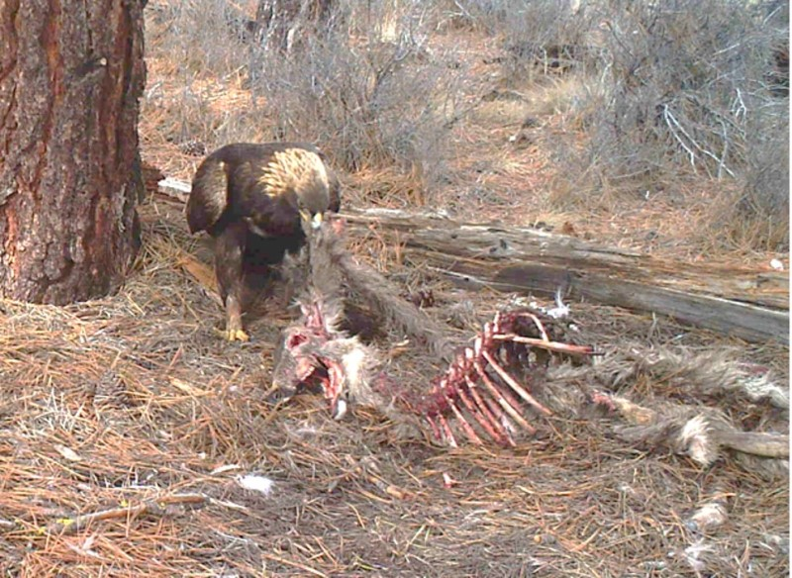
SLIDE 15.
Summary:Raptors use corvids to locate carrion.
Photo Matt Orr
Notes:
SUMMARY – – If you made a graph and ran statistics, you will have seen that the arrival times of corvids and raptors at carcasses are highly correlated. (If you did not, then take our word for it.) This was true both for the observational data and the experimental data, especially when the outlier was removed. So, not only do corvids benefit when raptors open a carcass, but raptors may benefit from corvids by using them to locate carcasses.
QUESTION 15 - At this point, how would you classify the overall interaction between raptors and corvids - (a) interference competition; (b) exploitative competition; (c) mutualism; (d) commensalism; (e) amensalism (f) none of the above? Explain why you chose your answer. Does your answer differ from your original hypothesis? If so, then this is one example of how scientific inquiry can help to form a more accurate view of the natural world.

Slide 19
Social information
SLIDE 16.
An animal (including you!) acquires information both individually, through direct trial and error, and socially, by observing other individuals.
A cue is any behaviour that inadvertently provides social information during performance of an activity.
For example, safari groups in Africa forming a cluster around an interesting wildlife sighting inadvertently provide a cue to distant groups that something interesting is happening.
Fishing boats may also use one another or seabirds as cues for where the action is.
Notes:
Some definitions

Slide 20
SLIDE 17.
In contrast to a cue, a signal intentionally conveys information.
For example, one safari vehicle (or boat captain) may transmit a radio signal to another to come and check out a wildlife sighting (or catch opportunity).
Signals are likely to occur only if they benefit both receiver and sender.
For example, safari vehicles from the same company may be more likely to signal one another than vehicles from different companies. What about boat captains?
Both raptors and corvids benefit when raptors use information from corvids to find carcasses, so it is appropriate to ask whether corvids send a cue or a signal about the location of carrion.
Notes:
Some definitions. Plus, are corvids sending cues or signals to raptors concerning the location of carcasses?

Slide 21
SLIDE 18.
To test whether corvids may signal the presence of carrion, scientists set out carcasses so that corvids would benefit from raptors at some carcasses but not at others.
How did they do that? You already know: Some carcasses were pre-opened with a hatchet, whereas others remained entirely covered by deer hide.
At which type of carcass do you think corvids would be more motivated to intentionally signal the location of the carcass to raptors?

Slide 22
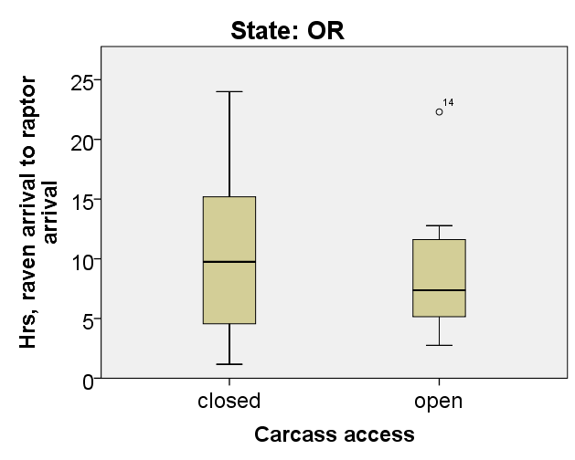
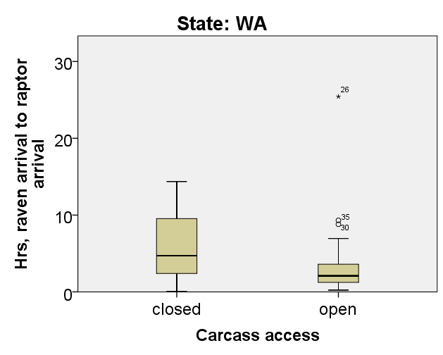
SLIDE 19.
Box and whisker plots show the time lag (Y axis) from when ravens first appeared at a carcass to when raptors first appeared at a carcass in Oregon (left) and Washington (right). “closed” = intact carcasses and “open” = pre-opened carcasses.
Notes:
QUESTION 16 - Do the results in this slide suggest that ravens use signals to recruit raptors to cut carcasses open for them? Explain your answer.

Slide 23
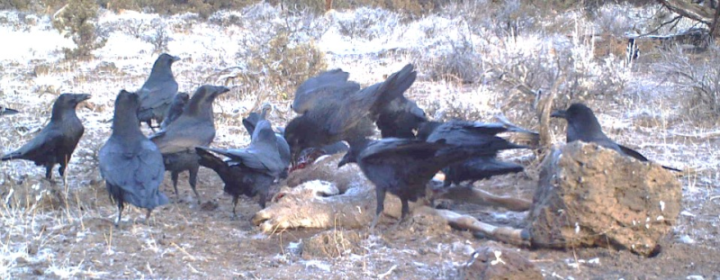
SLIDE 20.
Photo – Jon Nelson
Notes:
DISCUSSION - In this study, we discovered that individuals from one species use individuals from a different species (heterospecifics) to gain information about their environment, in this case the location of carrion. More often in nature, one species uses other individuals of the same species (conspecifics) to gather information about their environment.
QUESTION 17 - Why do you think it is more common for species to use social information from conspecifics than heterospecifics (underlined words defined Slide 2b)? (Choose all that apply) (a) For many species, individuals tend to be around conspecifics more often than heterospecifics; (b) conspecifics have a greater overlap in resource needs than heterospecifics, so information from a conspecific may be more likely to be relevant to survival; (c) individuals may be better able to interpret behaviors or signals of conspecifics than heterospecifics – e.g. vocal calls or pheromonal signals.
QUESTION 18 – Describe an instance you used cues from other humans to gain information about your environment.
QUESTION 19 - Now, try to think of and describe cases where you used information from another species to gain information about your environment.

Slide 24
SLIDE 21.
Hadza: How did they find carrion?
O’Connell et al. 1988 Current Anthropology 29: 356 – 363.
 | Guided by… | Not Guided
Vultures | 2 | 7
Hyenas | 1
Leopard (kill sounds) | 1
Notes:
DISCUSSION - Although use of heterospecific information by scavengers is not commonly documented in North America, it has been commonly observed in Africa. Jackals, hyenas, other vulture species, and even humans have been known to use circling vultures to find carcasses. In a study by O’Connell et al., Hadza Bushmen were found to get about 15% of their total meat intake by weight from carrion. They were guided by scavengers to the carrion in 4/11 of the instances in which they fed on carrion (see table).
QUESTION 20 – What proportion of their total meat intake do Hadza get by being guided by scavengers to carrion? Show your calculation.

Slide 25
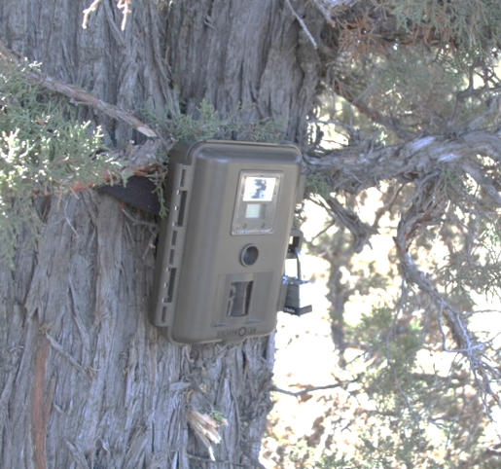
Behind the Scenes of the Science
SLIDES 22 +
This section is for fun. It is intended to give you some sense of how science is “made,” which may not always be evident from textbooks or journal publications. While the story told here is unique, it contains some useful generalities.

Slide 26
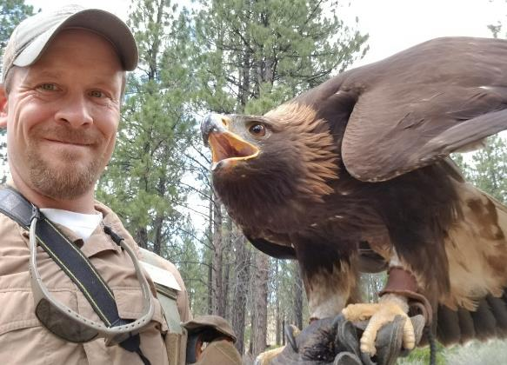
This project was initiated by Jon Nelson in 2011, who at the time was an undergraduate student in Matt Orr’s upper division Ecology class at OSU-Cascades in Bend, Oregon. Matt assigned students a 1-credit independent ecology project. Jon, who worked at the High Desert Museum near Bend, had noticed one day that a wide array of animals showed up when he had to dispose of some fish remains (for the museum’s otters) in the woods behind the museum. Based on this observation, Jon wanted to do a project on scavenging dynamics.
In terms of how science is “made,” all it took to get this project started was one observation and some curiosity (not to mention a course requirement ☺).
Jon in 2018 at work as Head Curator at the High Desert Museum

Slide 27
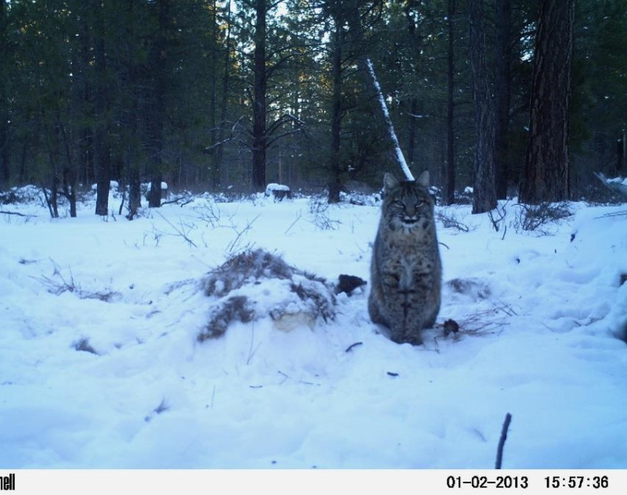
Our first challenge was to devise a hypothesis to test. We started with the idea of looking at discovery dynamics in habitat that had closed canopy, like a ponderosa pine forest, with habitat that had more open canopy, like sage-steppe. Both habitats are common around Bend.
We were also interested in devising a dominance hierarchy among scavengers visiting these carcasses.
In terms of how science is made, you have to start somewhere!
Photo J. Nelson

Slide 28
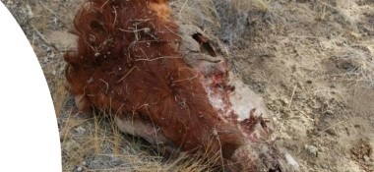
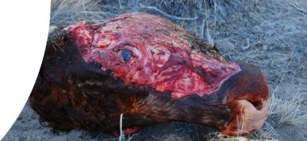
A third challenge was to find a somewhat uniform source of carrion. We started with cow heads from a slaughterhouse. (Again, you have to start somewhere.)
Above: After being scavenged.
Below: Just after being placed in the field.
Photos J. Nelson

Slide 29
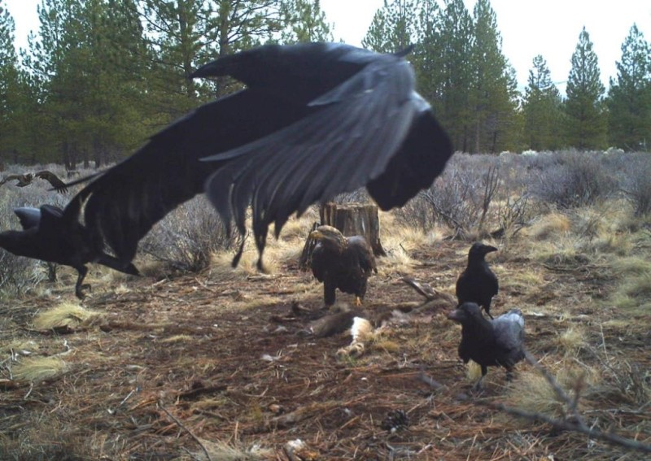
Jon’s class project put out six replicates and found a correlation between the appearance of ravens and the subsequent appearance of hawks or eagles at 5 of the 6 carcasses.
We thus reoriented our project toward discovery cues and signals and started it all over.
In terms of how science is “made,” this illustrates that you should not get too attached to your original ideas and should always be on the lookout for unexpected surprises to pursue.
Photo J. Nelson

Slide 30
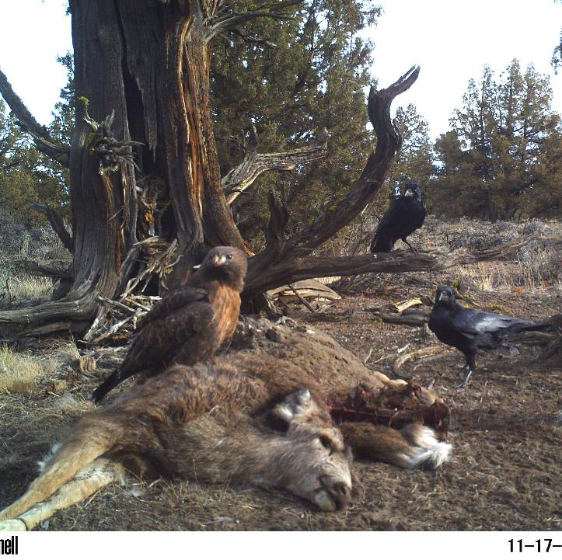
Jon obtained permits to use roadkill carcasses instead of cow heads for the new experiment.
(In addition to being more realistic, they were also more photogenic.)
Photo: J. Nelson

Slide 31
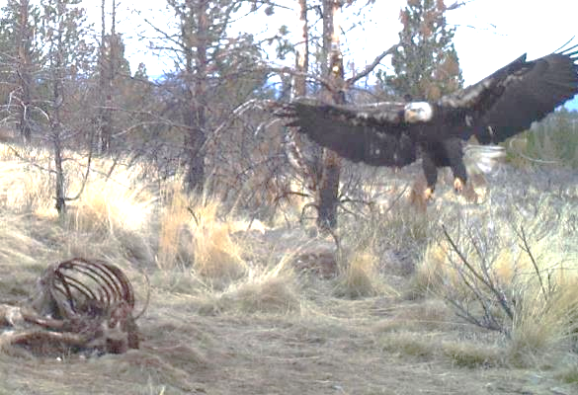
After getting a long way into the study and finding strong correlations in arrival times between ravens and eagles, we started to have doubts about what the pattern meant.
Was it possible that eagles waited around for other scavengers to approach the carcass, and only came down after it was safe?
If so, the limited views through our game cameras could provide a misleading view of discovery sequences.
In terms of how science is made, it is always good to be skeptical of your own findings and modify or add experiments to address alternative explanations, if necessary.
Photo M. Orr

Slide 32
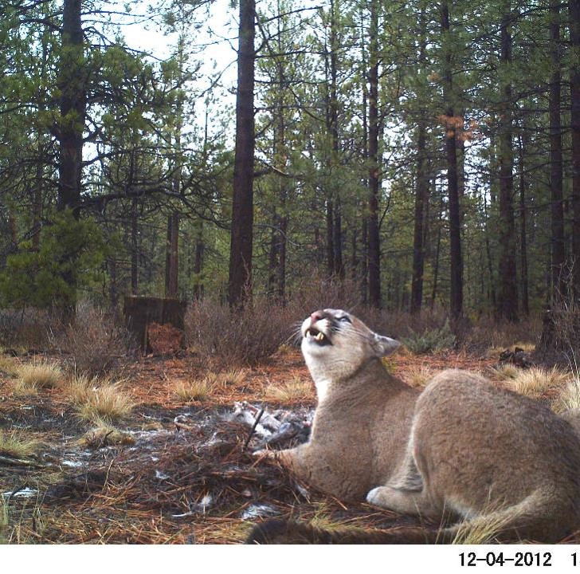
Risks to eagles scavenging at carcasses seemed real given that they never once appeared in a photo along side a bobcat or mountain lion. In fact, no bird of any species ever appeared with a cat in a photo. Clearly, eagles knew how to be careful.
(What is this cougar looking at?)
Photo: J. Nelson

Slide 33
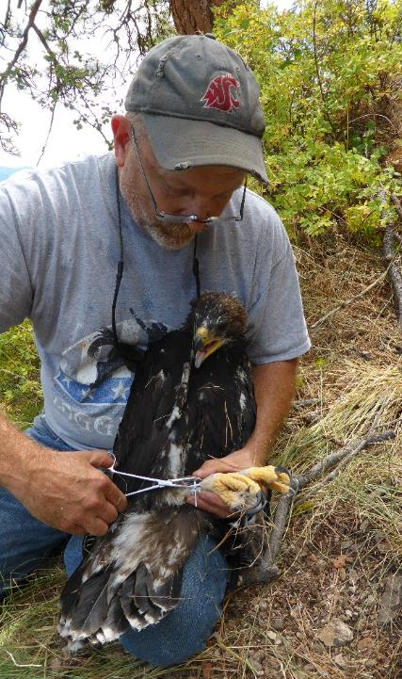
To address our curiosity about whether eagles may wait around a carcass before descending to it, we contacted an eagle expert, Jim Watson, from the Oregon Department of Fish and Wildlife. Jim had experience netting eagles, which required hanging around at a bait and therefore getting a sense of what eagles did when they arrived at it.
Matt called Jim, whom he had never met before, to ask Jim this question. There was an awkward moment when Jim said he, too, was putting out game cameras at deer carcasses to assess scavenger behavior.
It sounded like a possible case of competition, but we turned it into a mutualism by agreeing to pool our data sets for more replicates and a wider geographic range of study.
In terms of how science is made, successful projects increasingly require broad collaboration.
Jim Watson banding an eagle

Slide 34
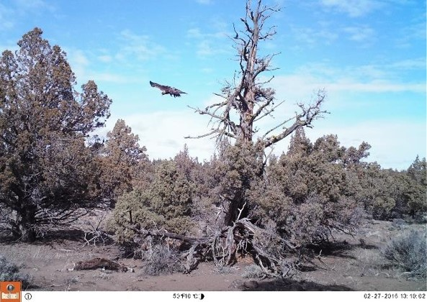
One way we sought to resolve the question of whether raptors hang around for a long time and descend to a carcass only after they see a raven “test driving” it, was to place carcasses under the only good perch in an area and aim our cameras on both the carcass (lower left) and the perch.
Although this showed that raptors spend only a few minutes perched before descending to a carcass, we still had further doubts about alternative explanations for our findings. This goes back to the same issue of being skeptical of your discoveries.
Photo: M. Orr

Slide 35
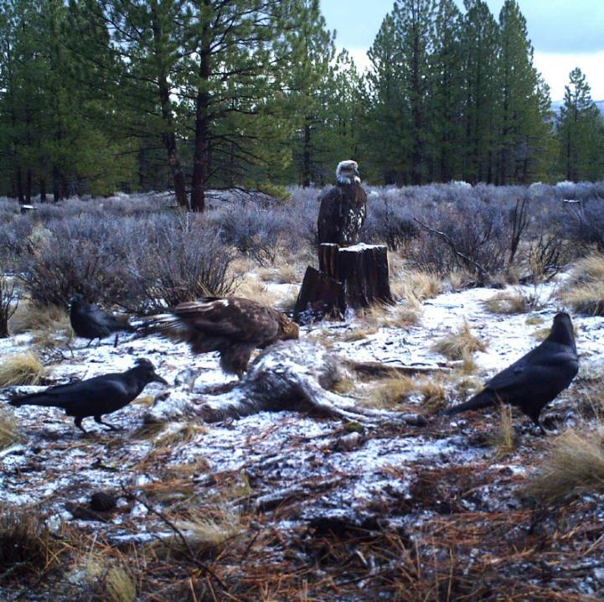
Another alternative explanation that concerned us is that if some habitats are better for all birds while others are worse, then different species would appear at carcasses early in high-density bird habitats and later in low-density habitats. This could create a correlation in arrival times between species that was based only on bird densities. This was another alternative explanation for our findings that we could not ignore.
Photo: J. Nelson

Slide 36
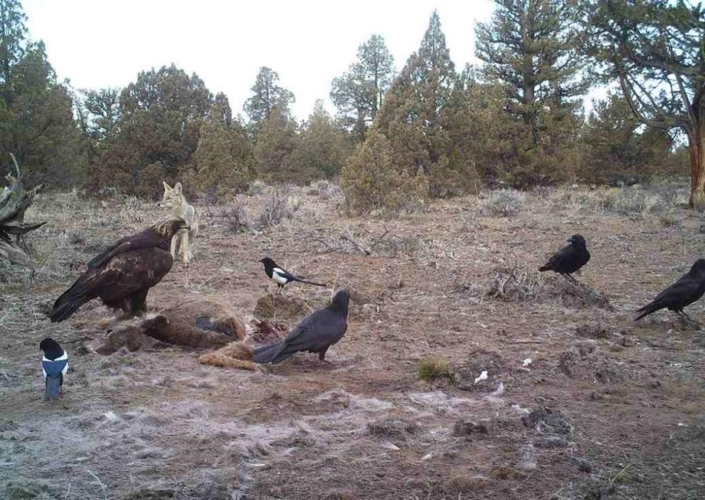
In terms of yet another alternative explanation, we knew that in Yellowstone ravens follow wolves around hoping for opportunities to feed at a wolf kill. If any of our focal species followed each other around like that, then they would appear coincidentally at carcasses without one species having provided a cue or signal about the carcass to the other.
Photo J. Nelson

Slide 37
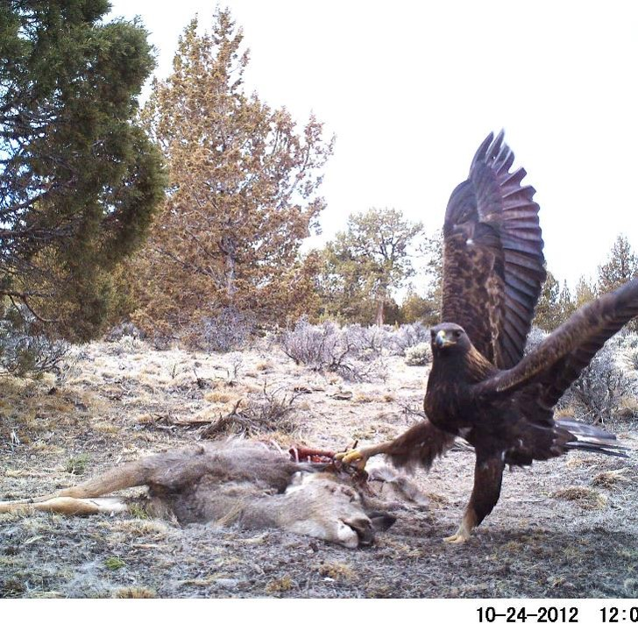
To alleviate these concerns, Matt ran some ideas for an experimental study past Jon to try to address these alternative explanations.
Jon’s expertise trapping eagles led him to propose artificial carcasses.
The thought was that during very cold times of year, raptors might be desperate enough to investigate even a fake carcass.
In terms of how science is made, observational studies can be a good start, but experimental manipulations are often needed to cleanly answer a question. Synthetic carcasses made it easy to create and deploy a lot of replicates with or without “ravens.”
Photo J. Nelson

Slide 38
In hindsight, the synthetic carcasses, which consisted of raven decoys and a game caller playing the sound of scavenging ravens, were unlikely to attract raptors due to raptors’ widespread distribution on the landscape and the narrow radius of the game caller playing back raven scavenging sounds.
In addition, static raven decoys would not have alerted raptors to the notion that anything of importance was happening.
In terms of how science is made, we are back to the idea of “you have to start somewhere.”
Photo: Soren Orr

Slide 39
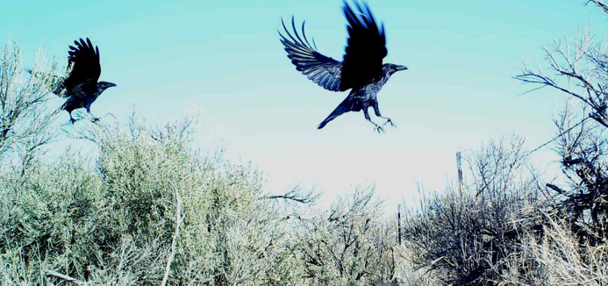
We were probably a bit lucky that the synthetic carcasses did attract both ravens and magpies, who sometimes circled over them.
These, in turn, attracted raptors.
The control carcasses did not attract ravens or magpies and did not attract raptors.
So, our question was answered, but not in the way we expected.
In terms of how science is made, a little luck never hurts.
Photo – M. Orr

Slide 40
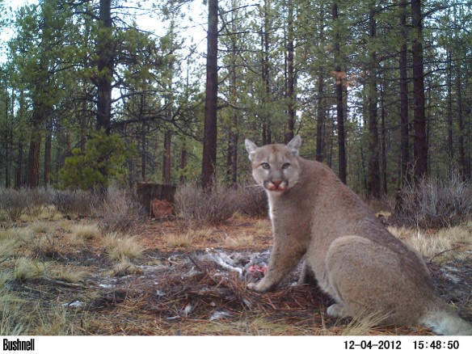
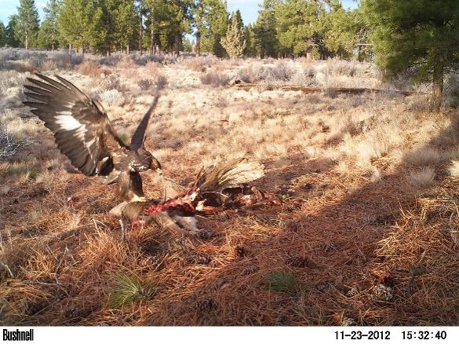
After conducting two different observational studies and an experimental study, all of which pointed to heterospecific cues, we thought we had some convincing findings.
However, in terms of how science is made, we still had to convince peer reviewers, whose job is to tear into your work with a helpful yet critical eye.
Photos J. Nelson

Slide 41
Problems posed by peer reviewers…
Our manuscript was rejected without being reviewed by the journals Ecology Letters and Oecologia.
It was reviewed by the Journal of Animal Ecology, but rejected for three main reasons:
Reviewers felt that we may have been measuring the same eagle repeatedly in some cases if our carcasses were not spread far enough apart.
Reviewers had a problem with the fact that in our experimental study we used the same 8 minute loop of raven foraging sounds (which we had made at a carcass) instead of using a different set of sounds for every replicate.
Reviewers felt our statistical analysis of our carcass discovery data should use more up-to-date generalized linear mixed models (GLMMs).

Slide 42
Responses to peer reviewers…
We addressed these problems as follows and resubmitted to Animal Behaviour, which accepted the manuscript after some further revision.
Using data on the sizes of eagle territories, we eliminated any possible replicates from within the same territory. There were only a few of these, and eliminating them did not change our results.
We emphasized that it was live ravens and magpies, not the raven audio recording, that attracted the raptors to synthetic carcasses, so using the same recording was not a problem because individual live ravens and magpies differed at each synthetic carcass, suggesting it was not just the behavior of one whacky corvid that attracted raptors.
Jim Watson reanalyzed our data using GLMMs.
In terms of how science is made, comments by peer reviewers greatly improved the scientific quality of our manuscript. Another lesson about how science is made is that initial rejection from a journal does not necessarily mean your research is worthless. It may just mean that your peer reviewers were diligent and thorough.

Slide 43
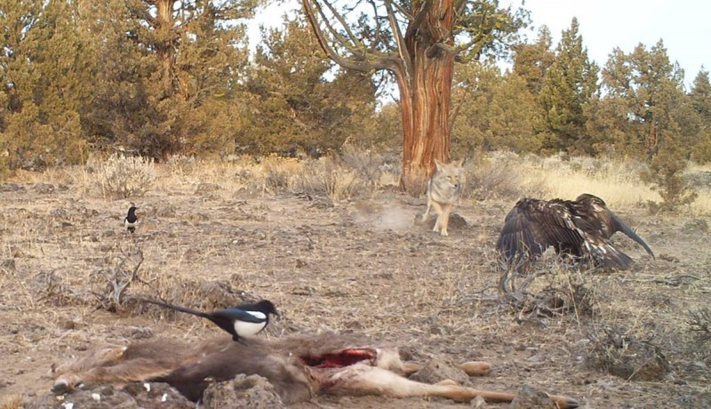
Further discussion – What about humans?
Human anatomical adaptions for endurance running may have originated to outrace other species to carcasses (see en.wikipedia.org/wiki/Endurance_running_hypothesis under “Endurance running and scavenging”). If so, it is not unrealistic to imagine that races to carcasses may have been precipitated by cues such as those provided by circling vultures. Perhaps this is a bit of a stretch to say this, but similar heterospecific cues to those studied here may have made humans faster.
Photo J. Nelson

