Slide 1
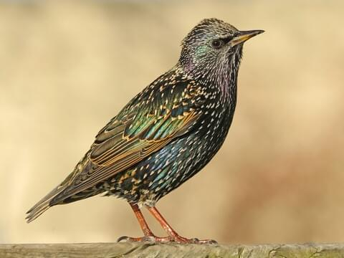
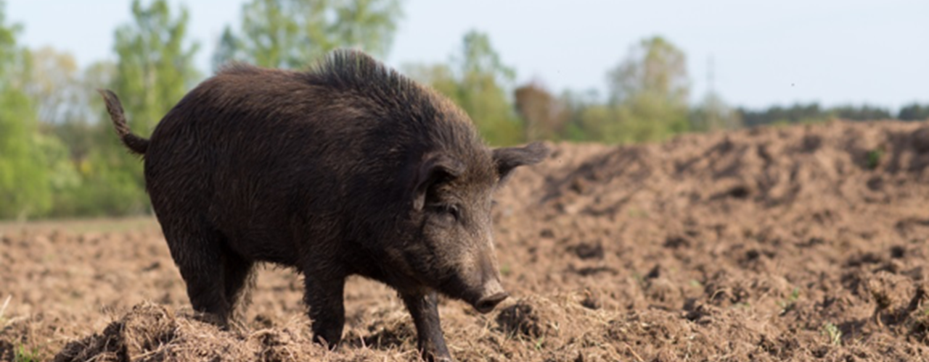
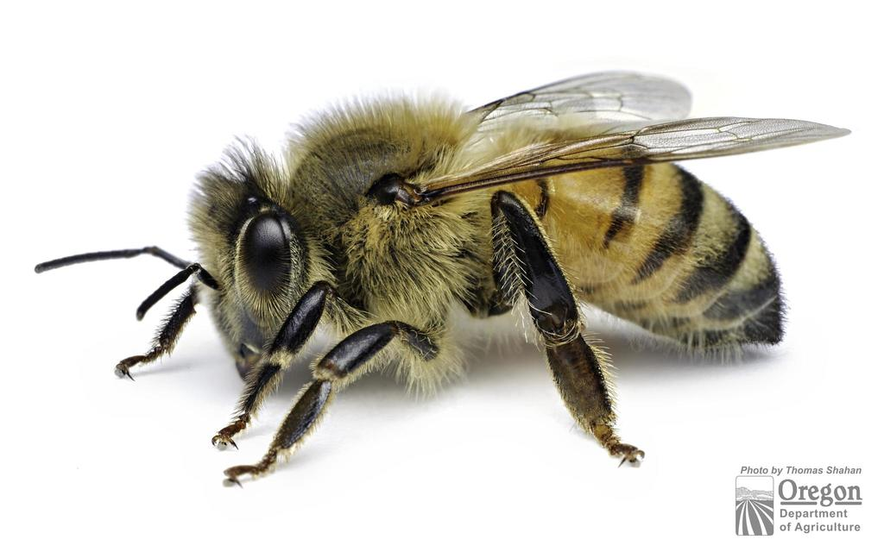
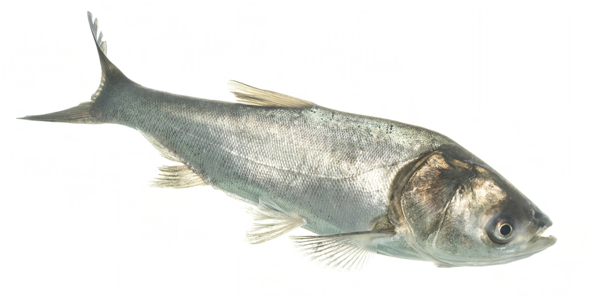
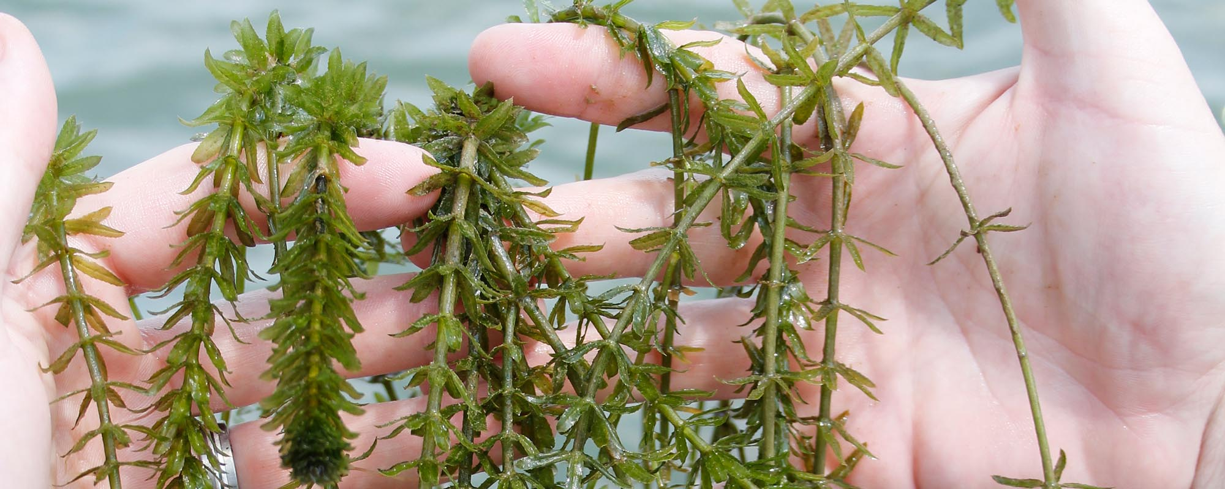
Introduced Species
2
3
1
European honey bee (Apis mellifera)
European starling
(Sturnus vulgaris)
feral pig/wild boar
(Sus scrofa)
4
5
hydrilla
(Hydrilla verticillata)
silver carp
(Hypophthalmichthys molitrix)
Notes:
These are the five species included in the jigsaw handouts. These species can be changed to include introduced or invasive species that are common in your area.

Slide 2

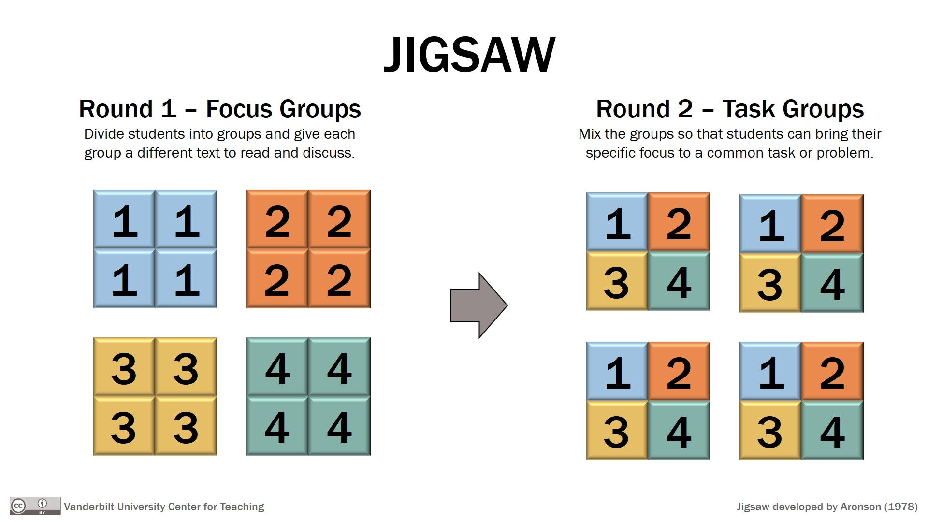
Jigsaw activity
Round 1: Independent Reading
Receive your fact sheet and take time to read through it quietly before moving to Round 2. Think about key points.
(5-10 minutes)
Round 2: Focus Groups
Discuss 3 key points about your species to share with others in Round 3. Write your key points down on your worksheet.
(15-20 minutes)
Round 3: Sharing Groups
Each individual will share 3 key points about their species, so you can learn about 4 other species. Write the key points for those species on your worksheet.
(3-4 min/person, 15-20 min)
Notes:
This slide provides the steps of the jigsaw activity, so you can explain to the students how the activity is going to go. Distribute the reflection handout now, so students can write on their sheets as they meet within the groups.

Slide 3
Jigsaw Reflection Activity
Complete your worksheet with your 3 key points for each species.
Write a reflection at the bottom of the worksheet.
  What did you find interesting about these species you learned about during the activity?
  How did your perceptions of introduced and invasive species change as a result of this class? Why do you think that is?
Notes:
This slide provides the prompts for the rest of the reflection activity. Prompt the students to reflect on what they found interesting about the species they learned today and see if their perceptions of introduced and invasive species changed as a result of the activity. Many students will likely say that they still do not like introduced and invasive species because of a bad experience they had with one, but you usually get a couple who comment on not thinking about positive impacts of invasive species or indigenous perspectives before this class.

